Slide 1

Connect Four
connecting blocks on the blockchain

Slide 2
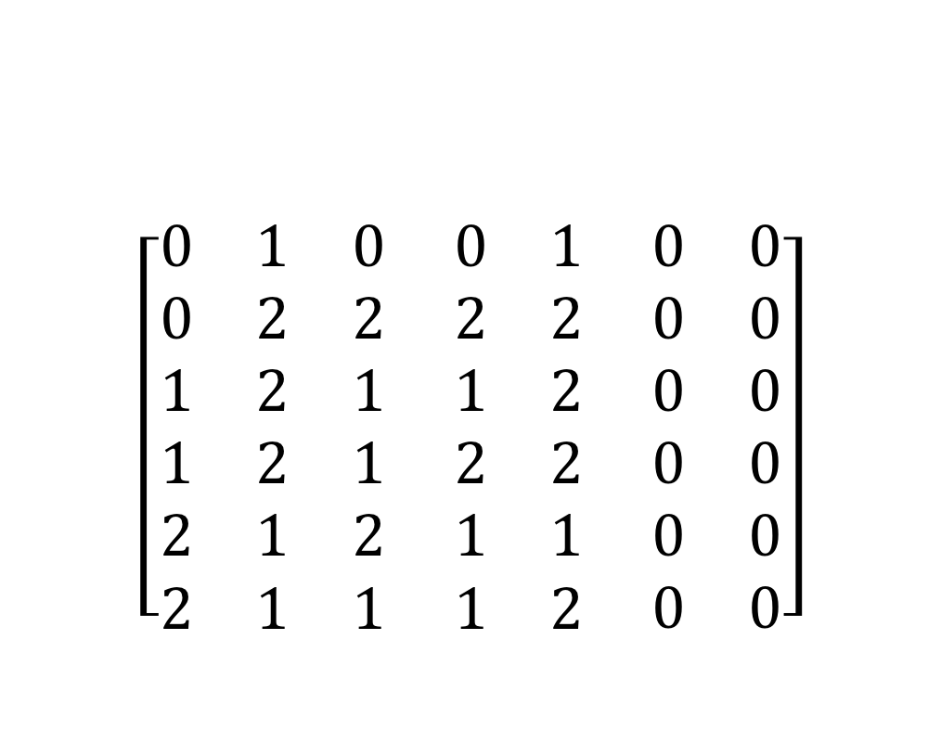
The Concept
$$\left[\begin{matrix}0 & 1 & 0 \\ 0 & 2 & 2 \\ 1 & 2 & 1 \\ 1 & 2 & 1 \\ 2 & 1 & 2 \\ 2 & 1 & 1\end{matrix} \begin{matrix}0 & 1 \\ 2 & 2 \\ 1 & 2 \\ 2 & 2 \\ 1 & 1 \\ 1 & 2\end{matrix} \begin{matrix}0 & 0 \\ 0 & 0 \\ 0 & 0 \\ 0 & 0 \\ 0 & 0 \\ 0 & 0\end{matrix}\right]$$
Let’s create a simple turn-based game for 2 players.
Connect Four
Front-End necessary
Let them play for ETH and we take a cut.
Connect four is a solved game!
Restrictions
Incentives
Notes:
Playing with a grid is not as fun -> front-end

Slide 3
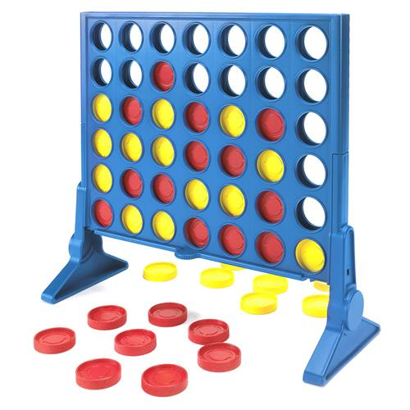
The Concept
Let’s create a simple turn-based game for 2 players.
Connect Four
Front-End necessary
Let them play for ETH and we take a cut.
Connect four is a solved game!
Restrictions
Incentives
Notes:
Play for ETH with a few adjustments

Slide 4
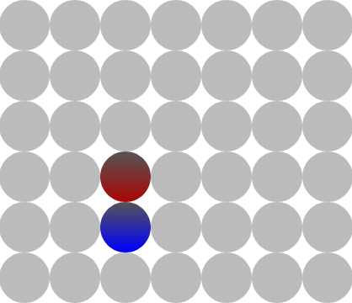
Adjustments
Solved game:
Modify the rules and make it harder!
Restrictions:
Bet can be 0.01 to 5.00 ETH
Incentives:
Incentive for losing player to give up
Notes:
Incentive: Winner receives his prize earlier when the loser gives up -> so, we give the loser a small payout (sending the «give up» transaction should not be a penalty)
Restriction: bet from 0.01 to 5 eth, game should be worth it, prize can’t be smaller than transaction cost for turns. There may be a tiny chance for a miner to act badly -> maximum eth -> lower incentive (is this true?)
Solved game: we added a twist to the game to make it harder to follow the «winning strategy»
New setup: these are set in stone! New stones fall through these!

Slide 5
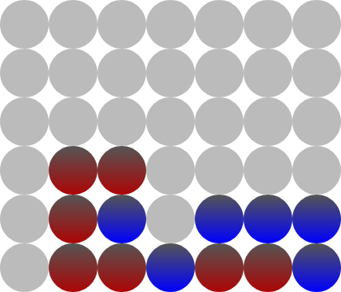
The Rules in General
Player 1 sets bet (0.01 – 5.00 ETH)
Player 2 matches the bet
Player 2 starts the game with another transaction (PRNG)
The game randomly assigns one stone per player and determines the starting player
Goal: connect 4 stones of your color in a row, column or diagonal
When the time per turn runs out, any party can end the game. The idle player loses!
Giving up gives the losing player a small amount of ETH
The winner takes it all! (Well, most of it…)
Notes:
Explain OUR rules
Possiblity to win (BLUE)
Special case: there may be 5 in a row! Make sure the contract allows this as well!

Slide 6
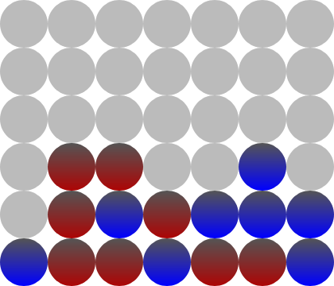
The Rules in General
Player 1 sets bet (0.01 – 5.00 ETH)
Player 2 matches the bet
Player 2 starts the game with another transaction (PRNG)
The game randomly assigns one stone per player and determines the starting player
Goal: connect 4 stones of your color in a row, column or diagonal
When the time per turn runs out, any party can end the game. The idle player loses!
Giving up gives the losing player a small amount of ETH
The winner takes it all! (Well, most of it…)
Notes:
Possibility to win (RED)
Special Case: player wins in two ways. Make sure the contract doesn’t do anything twice... (like a payout)

Slide 7
The Smart Contract
What the smart contract does:
Provides the rule set
Checks for equal bets
Starts a game (PRNG)
Most challenging function: has a player won the game?
Payout
Notes:
The smart contract provides the rule set, checks if both players set the same bet, adds 2 random stones and determines the starting player. We will see that in a bit, SC acts as a referee: are all turns legal?
It has to check if a player has won! We will take a look at this function

Slide 8
Function: checkVictoryCondition
function checkVictoryCondition(uint8 _col, uint8 _row) private {
(…)
// right side
uint8 currentStoneOwner = activePlayer;
uint8 currentCol = _col;
while (currentStoneOwner == activePlayer && currentCol <= 6) {
victoryPoints++;
currentCol++;
if (currentCol <= 6)
currentStoneOwner = grid[currentCol][_row];
}
(…)
Notes:
Function explanation:
New variable -> active player
If it’s player 1’s turn: set this variable to 1
Else: set variable to 2
We check horizontally, vertically and horizontally.
For time and space purposes we only look at one case:
New variable which is equal to active player
New variable which is equal to the chosen column (column in which the stone was placed)
While loop: we move from column to column for as long as the owner of the stone is the active player and the column number is at the highest 6. When all these criterias are met, we add one victory point
Having 4 (or more) victory points starts the playerWon function (not on this slide)
The SC does this horizontally (left, right), vertically (down) and diagonally (all directions).
QUESTION FROM MG: Wie versteht der SC, wenn wir einen Stein in der Mitte der Siegesstrasse legen?
zB: 011_10 -> 011110. sucht der contract jetzt nicht nur von _ aus nach rechts (und entdeckt 2 victorypoints?), verwirft das ganze, sucht wieder nach links (und entdeckt 3 victorypoints?)?

Slide 9
Pseudo-Random Number Generator
Don’t use block variables of a past block
Block variables of current block?
Block hash? …nope
Others? …possible but be aware of miner incentives
Our solution:
Two-step approach
Notes:
Use hash of block when player two joins the game ex post
Second transaction («start game») within 240 blocks that combines blockhash of join-transaction with coinbase address using XOR (NOT hash)
Random seed
Linear congruential algorithm to derive n random numbers
// Linear Congruential Generator (C++11's minstd_rand: ISO/IEC 14882:2011)

Slide 10
Pseudo-Random Number Generator
function rand() private returns (uint256) {
// use randomSeed as X_0
// X_(n+1) = a*X_n + c mod m
// a = 48271, c = 0, m = 2**32-1 (=4294967295)
currentRandomNumber = (48271 * currentRandomNumber) % 4294967295;
return currentRandomNumber;
}
Notes:
Linear Congruential Generator (C++11's minstd_rand: ISO/IEC 14882:2011)

Slide 11
Function: setUpGame
function setUpGame() private {
currentRandomNumber = uint(player2JoinBlockHash ^ bytes32(uint256(startCoinbase) << 96));
player1Turn = (currentRandomNumber % 2) == 0;
(…)
// set stone for player 2
uint8 row2;
uint8 col2;
do {
row2 = uint8((rand() % 4)) + 1;
col2 = uint8((rand() % 4)) + 1;
if (col2 >= 3)
col2++;
}
while (col1 == col2 && row1 == row2);
grid[col2][row2] = 2;
}
Notes:
Explanation:
PRNG

Slide 12
Security Problems
Code
Explain why certain functions may be subject to attack and how we could solve this
Notes:
Is this slide necessary?

Slide 13
Let’s Play
on 4blocks.ch

